Slide 1
Chapter 2
Threads and thread synchronization

Slide 2
Outline
Processes
Process states
Threads
Process vs. threads
Types of threads
Thread synchronization

Slide 3
What is process?
A process is an instance of a computer program in execution. When we ask a computer system to run a program the code for that program is loaded from disk into memory and executed as a process in the system on some platforms.
Processes might be called jobs or tasks on a modern system.
A process consists of one or more threads of execution.
A process can execute one instruction a time or can execute several instructions at a time on the CPU.
Each process on the system receives its own private allocation of resources
Each process also has access to its own data and the operating system maintain statistics about each process in order to make effective scheduling decisions in memory.

Slide 4
Cont…
A process is divided into segments program code and other read-only data are placed into the text segment.
Global variables in a program have their own data segment that allows both reading and writing automatic variables or local variables and functions are allocated at compile time and placed on the stack.
Process memory is divided into four sections:
The text section comprises the compiled program code, read in from non-volatile storage when the program is launched.
The data section stores global and static variables, allocated and initialized prior to executing main.
The heap is used for dynamic memory allocation, and is managed via calls to new, delete, free, etc.
The stack is used for local variables. Space on the stack is reserved for local variables when they are declared.

Slide 5
if a process makes use of shared libraries these libraries are mapped into process memory between the stack and in order to track processes correctly and allow multiple processes to share the same system the operating system must track some information that is associated with each process
This information includes that the process is using and the current location in the process code that is executing known as the process program counter
The operating system must also track other resources in use by a process including which files are currently open and any network connections the process is using .

Slide 6
Cont’d
The operating system must keep scheduling information and this information includes a unique identifier or process ID
It can be used to distinguish processes from each other in order to arbitrate access to system resources the operating system must also store information about the owner of a process so that permissions can be enforced correctly to facilitate scheduling decisions
The operating system collects various statistics about process execution such as the amount of CPU time consumed and the amount of memory used during the lifetime of a process
The process moves between several states about each process

Slide 7
Process state
As a process executes, it changes its state
New: the process is being created
Running: instructions are being executed
Waiting: the process is waiting for some event to occur
Ready: the process is waiting to be assigned to a CPU
Terminated: the process has finished execution

Slide 8
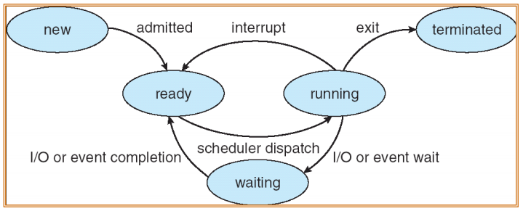
Process state Cont’d

Slide 9
Cont’d
When a process is first created it is initially in the new state once creation is complete and the process is ready to run it transition to the ready state where it waits to be assigned to a CPU core
when the scheduler selects a ready process to run that process is moved to the running state and is given CPU resources during execution a process might request external resources such as disk I/O since these resources take time to provide the process is moved out of the running state and into the waiting state so that the CPU core can be given to another process

Slide 10
Context switch
When an event occurs, the operating system saves the state of the active process and restores the state of the interrupt service routine (ISR).
This mechanism is called a Context Switch.
What must get saved? Everything that the next process
could or will damage. For example:
– Program counter (PC)
– Program status (PS)
– File access pointer(s)
– Memory
While saving the state, the operating system should mask (disable) all interrupts. Why?

Slide 11
Threads
Thread is an execution unit which consists of its own program counter, a stack, and a set of registers.
Program counter stores the address of current thread while register stores the instruction.
Threads are also known as “Lightweight processes’’. Threads are popular way to improve application through parallelism. The CPU switches rapidly back and forth among the threads giving illusion that the threads are running in parallel.
As each thread has its own independent resource for process execution, multiple processes can be executed parallel by increasing number of threads.

Slide 12
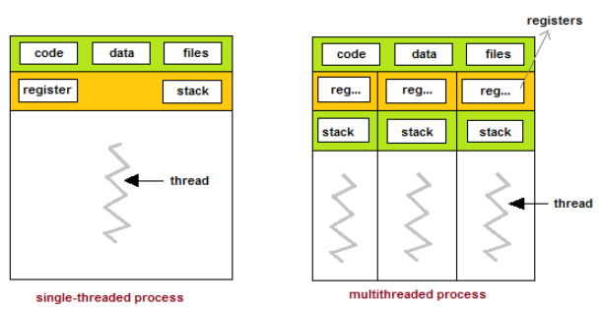
Cont’d

Slide 13
Types of threads
There are two types of threads.
User threads
are above the kernel and without kernel support. These are the threads that application programmers use in their programs.
To make threads cheap and fast, they need to be implemented at user level.
User-Level threads are managed entirely by the run-time system (user-level library).
The kernel knows nothing about user-level threads and manages them as if they were single-threaded processes.
Example: thread in java program.

Slide 14
Advantages:
The most obvious advantage of this technique is that a user-level threads package can be implemented on an Operating System that does not support threads.
User-level threads does not require modification to operating systems.
Simple Representation: Each thread is represented simply by a PC, registers, stack and a small control block, all stored in the user process address space.
Simple Management: This simply means that creating a thread, switching between threads and synchronization between threads can all be done without intervention of the kernel.
Fast and Efficient: Thread switching is not much more expensive than a procedure call.

Slide 15
Disadvantages:
User-Level threads are invisible to the OS they are not well integrated with the OS. As a result, OS can make poor decisions like scheduling a process with idle threads,
blocking a process whose thread initiated an I/O even though the process has other threads that can run and unscheduling a process with a thread holding a lock. Solving this requires communication between kernel and user-level thread manager.
There is a lack of coordination between threads and operating system kernel. Therefore, process as whole gets one time slice irrespective of whether process has one thread or 1000 threads within. It is up to each thread to relinquish control to other threads.

Slide 16
Kernel threads
are supported within the kernel of the OS itself.
All modern OSs support kernel level threads, allowing the kernel to perform multiple simultaneous tasks and/or to service multiple kernel system calls simultaneously.
Are some times referred as light weight process.
Example: Solaris: Lightweight processes(LWP).
Solaris is an enterprise OS for oracle database and java application.

Slide 17
Advantages:
Because kernel has full knowledge of all threads, Scheduler may decide to give more time to a process having large number of threads than process having small number of threads.
Kernel-level threads are especially good for applications that frequently block.
Disadvantages:
The kernel-level threads are slow and inefficient. For instance, threads operations are hundreds of times slower than that of user-level threads.
Since kernel must manage and schedule threads as well as processes. It require a full thread control block (TCB) for each thread to maintain information about threads. As a result there is significant overhead and increased in kernel complexity.

Slide 18
Processes vs. threads
A process is an executing instance of an application. for example, when you double-click the Microsoft Word icon, you start a process that runs Word.
A thread is a path of execution within a process. Also, a process can contain multiple threads. When you start Word, the operating system creates a process and begins executing the primary thread of that process.
A process can consist of multiple threads. Thus, the difference between a thread and a process is the work that each one is used to accomplish. Threads are used for small tasks, whereas processes are used for more ‘heavyweight’ tasks- basically the execution of applications.
Threads within the same process share the same address space, whereas different processes do not. This allows threads to read from and write to the same data structures and variables, and facilitates communication between threads.
Communication between processes – also known as IPC (inter-process communication) is quite difficult and resource-intensive.

Slide 19
Differences b/n processes and threads
Process
Heavy weight
Process switching needs interaction with operating system
In multiple processing environments, each process executes the same code but has its own memory and file resources
If one process is blocked, then no other process execute until the first process is unblocked
Each process operates independently to others
Thread
Light weight
Thread switching doesn’t need to interact with the operating system
All threads can share same set of open files, child processes
While one thread is blocked and waiting a second thread is in the same task can run
One thread can read, write and change another threads data

Slide 20
Multi-threading
Threads allow for multi-threading. A common example of the advantage of multithreading is the fact that you can have a word processor that prints a document using a background thread, but at the same time another thread is running that accepts user input, so that you can type up a new document.
If we were dealing with an application that uses only one thread, then the application would only be able to do one thing at a time so printing and responding to user input at the same time would not be possible in a single threaded application.
Each process has its own address space, but the threads within the same process share that address space. Threads also share any other resources within that process. This means that it’s very easy to share data amongst threads, but it’s also easy for the threads to step on each other, which can lead to bad things.

Slide 21
Multi-threading Models
The user threads must be mapped to kernel threads, by one of the following strategies:
Many to One Model
One to One Model
Many to Many Model

Slide 22
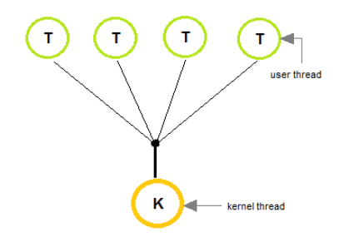
Many to One Model
In the many to one model, many user-level threads are all mapped onto a single kernel thread.
Thread management is handled by the thread library in user space, which is efficient in nature.

Slide 23
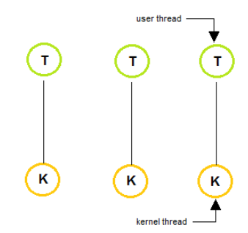
One to One Model
The one to one model creates a separate kernel thread to handle each and every user thread.
Most implementations of this model place a limit on how many threads can be created.
Linux and Windows from 95 to XP implement the one-to-one model for threads.

Slide 24
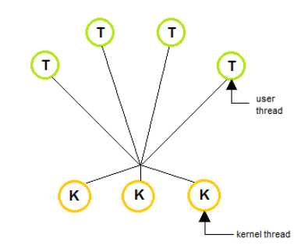
Many to Many Model
The many to many model multiplexes any number of user threads onto an equal or smaller number of kernel threads, combining the best features of the one-to-one and many-to-one models.
Users can create any number of the threads.
Blocking the kernel system calls doesn’t block the entire process.
Processes can be split across multiple processors.

Slide 25
Benefits of Multithreading
Responsiveness- a program continues running even if some part of it is blocked
Resource sharing: allowing better utilization of resources.
Economy: Creating and managing threads becomes easier.
Scalability. One thread runs on one CPU. In Multithreaded processes, threads can be distributed over a series of processors to scale.
Context Switching is smooth. Context switching refers to the procedure followed by CPU to change from one task to another.

Slide 26
Thread synchronization
Thread synchronization is the concurrent execution of two or more threads that share critical resources.
Threads should be synchronized to avoid critical resource use conflicts. Otherwise, conflicts may arise when parallel-running threads attempt to modify a common variable at the same time.
To clarify thread synchronization, consider the following example: three threads - A, B, and C - are executed concurrently and need to access a critical resource, Z.
To avoid conflicts when accessing Z, threads A, B, and C must be synchronized. Thus, when A accesses Z, and B also tries to access Z, B’s access of Z must be avoided with security measures until A finishes its operation and comes out of Z.

Slide 27
Cont’d
In Java, two synchronization strategies are used to prevent thread interference and memory consistency errors:
Synchronized Method: Includes the synchronized keyword in its declaration. When a thread invokes a synchronized method, synchronized method automatically acquires the intrinsic lock for that method's object and releases it when the method returns, even if that return was caused by an uncaught exception.
Synchronized Statement: Declares a block of code to be synchronized. Unlike synchronized methods, synchronized statements should specify the objects that provide the intrinsic lock. These statements are useful for improving concurrency with fine-grained synchronization, as they enable the avoidance of unnecessary blocking.

Slide 28
THANK YOU ??

